Slide 1
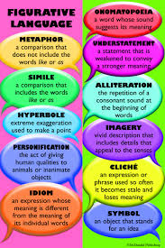
More Figurative Language
Connotation
Idiom
Symbolism
Allusion
Irony

Slide 2
Connotation
An idea or quality that a word makes you think or feel in addition to its meaning.

Slide 3
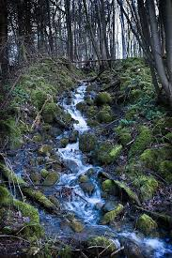
Examples of Connotation
The words underlined describe movement of water, but each has a very different connotation. They would each look different in the mind of the reader.
The stream trickled over the rocks.
The stream gushed over the rocks.
The stream surged over the rocks.
The stream cascaded over the rocks.

Slide 4
Idiom
A phrase that doesn’t mean exactly what it says.

Slide 5
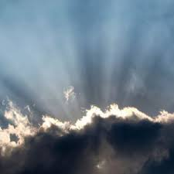
Example of idiom
Every cloud has its silver lining.
If we play our cards right, we might get to go to the movies.
You’ve known that forever.

Slide 6
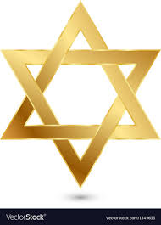
Symbolism
Using an object or a word to represent an abstract idea
The Star of David is a symbol of Judaism.
The dove is a symbol of peace.

Slide 7
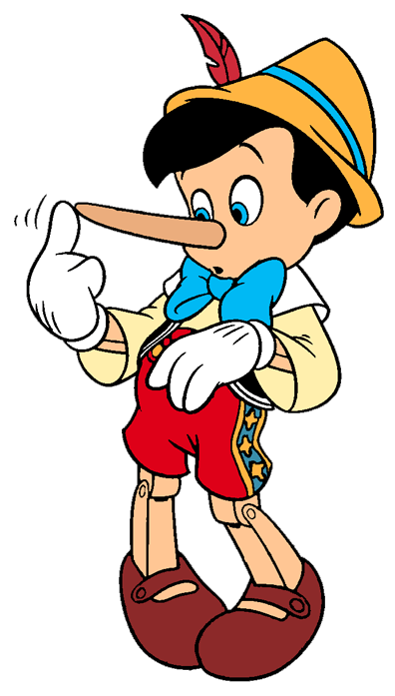
Allusion
A brief and indirect reference to a person, place, thing or idea of historical, cultural, literary or political significance.
This place is like a Garden of Eden.
He was a real Romeo with the
ladies.
I was surprised his nose was not
growing like Pinocchio’s.

Slide 8
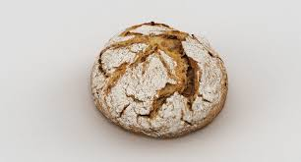
Irony
When the opposite of what is meant is said, or the opposite of what is expected occurs
When in response to a foolish idea, we say, “what a great idea!” it is a verbal irony.
I posted a video on YouTube about how boring and useless YouTube is.
Mr. Van Daan complaining
about how little food there
is to eat in the attic is ironic.

Slide 9
Poetry Terms You Should Know
Rhythm
Rhyme
Rhyme Scheme
Free Verse
Stanza

Slide 10
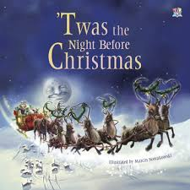
Rhythm
The word rhythm is derived from rhythmos (Greek) which means, “measured motion.” It is the regular, repeated pattern of sound.
“T’was the Night Before Christmas” has a rhythm that is created by using a pattern of two unstressed and one stressed syllable:
T’was the night before Christmas
and all through the house
not a creature was stirring
not even a mouse.

Slide 11
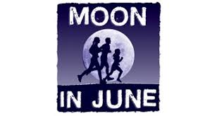
Rhyme
A rhyme is one of two or more words or phrases that end in the same sounds.
She used “moon” as a rhyme for “June.”

Slide 12
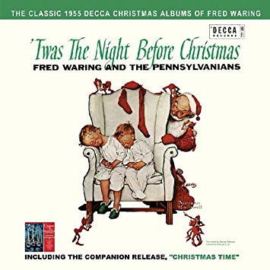
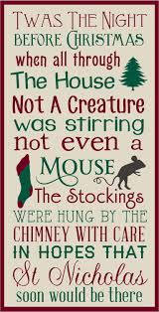
Rhyme Scheme
The pattern of rhymes at the
ends of the lines of a poem or verse.
A, B, B, A
A, B, A, B,
A,B,C,B

Slide 13
Free Verse
Free verse poems do not follow the rules, and have no rhyme or rhythm; but they are still an artistic expression

Slide 14
Stanza
Stanzas in poetry are similar to paragraphs in pros(anything written that is NOT poetry).
Both stanzas and paragraphs include connected thoughts, and are set off by a space. The number of lines varies in different kinds of stanzas.

