Slide 1
Examining the “text”
Teaching Elements of Argumentative Writing through Paintings
UCTE presentation — November 10, 2017
DeAnna Stallings & Carol Nielsen
Logan City School District
You can find a copy of our PowerPoint on Carol’s webpage. You are welcome to use it in your own classroom and modify it as needed. Please, just credit the source.
http://cnielsenmlms.weebly.com/

Slide 2
Today’s Objective:
I can make and support a claim using textual evidence and warrant of proof.

Slide 3
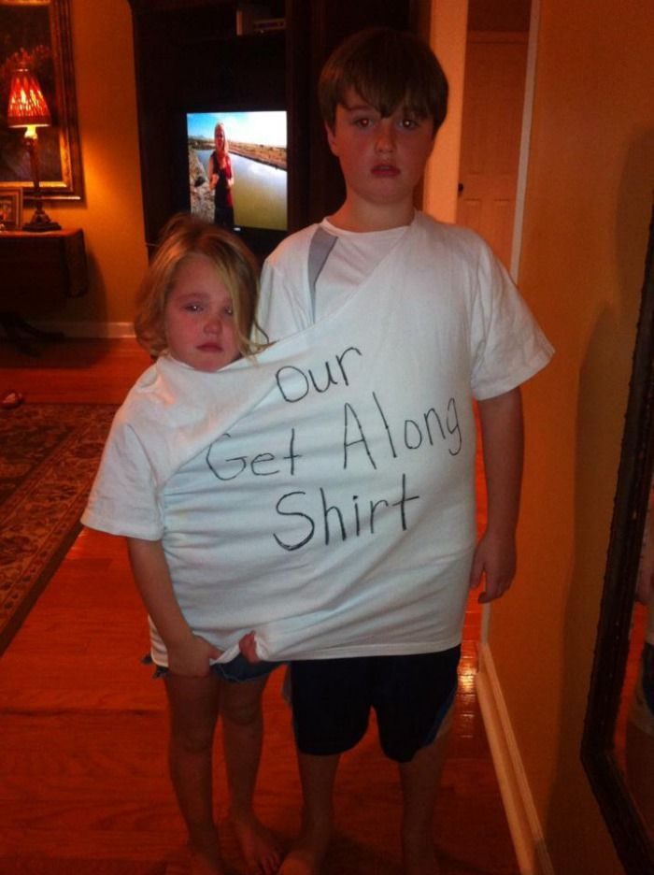
“A Picture is Worth a Thousand Words”
What do you see in the “text”?
What do you infer from what you see? Make a CLAIM.
Cite the “TEXT” EVIDENCE that supports your claim.
Explain your text evidence. SAY MORE STUFF!!! That’s your WARRANT OF PROOF.
Tree map

Slide 4
Tree Map
See Infer Cite Explain
(facts) (Claim) (Support) (Warrant)

Slide 5
Without thinking too much about it in specific terms, I was showing the America I knew and observed to others who might not have noticed. —Norman Rockwell
Notes:
A picture is worth a 1000 words, but Norman Rockwell might be worth more. Using his paintings as “text” evidence has been wildly successful. There are so many details and nuances to examine. Last year, one of my students said, “Wait, those seriously aren’t photographs? Our students have been incredibly engaged in the process. It’s hard to stop the discussion sometimes. An Rockwell, in addition to his “Americana” paintings, in his pater career also painted some works that have profound social commentary. He was not afraid to stir up a little controversy.

Slide 6
Norman Rockwell’s Self Portrait
Notes:
We begin with an introduction to who Rockwell was. And what he did. That can be as long or short as you wish.

Slide 7
A Brief Biography of Norman Rockwell - source: The Norman Rockwell Museum http://www.nrm.org/about-2/about-norman-rockwell/
He was born in New York City in 1894.
While still in his teens, he was hired as art director of Boys’ Life.
In 1916, the 22-year-old Rockwell painted his first cover for The Saturday Evening Post
Over the next 47 years, another 321 Rockwell covers would appear on the cover of the Post.
In 1962, he began to work for Look magazine and in the next 10 years painted pictures illustrating some of his deepest concerns and interests, including civil rights, America’s war on poverty, and the exploration of space.
He died in 1978.
Notes:
These are some details that I want them to know for sure.

Slide 8
"Lion and His Keeper"
Notes:
Some of his paintings just have pure entertainment value and whimsy.

Slide 9
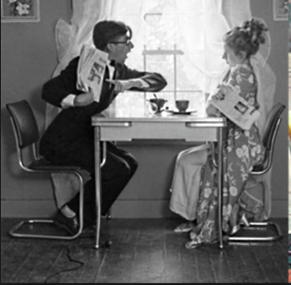
Notes:
It’s interesting to show how he used photos as the basis for his paintings. For the artists in your classroom, this is particularly fascinating. He used a lot of his family and neighbors as models.

Slide 10
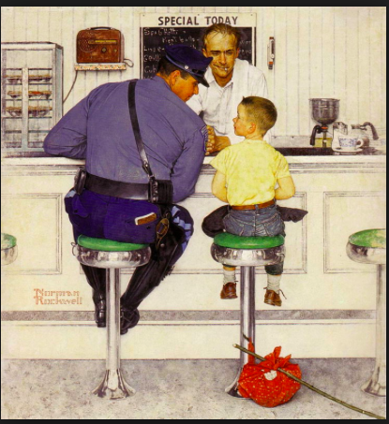

Slide 11
Norman Rockwell’s Rosie the Riveter
Notes:
But he also definitely touched on historically significant moments.

Slide 12
In 1943, inspired by President Franklin Roosevelt’s address to Congress, Rockwell painted the Four Freedoms paintings.
Notes:
He definitely has a place in the fabric of history.

Slide 13
Norman Rockwell’s Portrait of President Richard M. Nixon- National Portrait Gallery

Slide 14
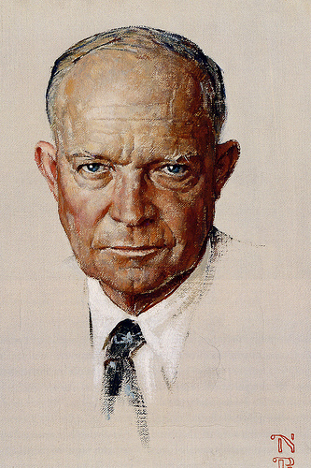
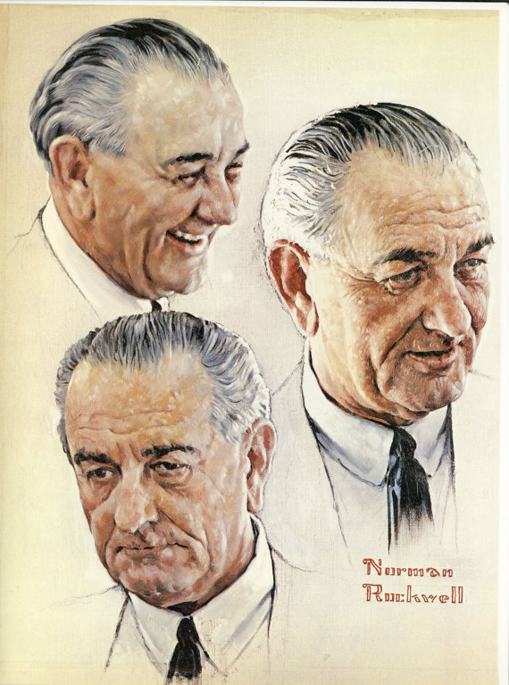
He also painted Presidents Eisenhower, Kennedy and Johnson (although these are not the NPG portraits)

Slide 16
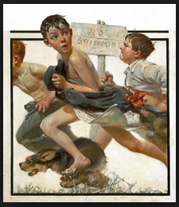
Tree Map
See Infer Cite Explain
(facts) (Claim) (Support) (Warrant)

Slide 17
Make a claim. In this case, your claim will explain what’s happening in this painting. Don’t confuse a claim with a fact. It’s a fact that there are three boys in the painting. No one will argue that. A claim can be argued. A claim involves inference (looking at the evidence and coming to a conclusion).
Notes:
Title: No Swimming

Slide 18
Support your claim. Explain what evidence proves your claim. Explain your inferences. Just because you saw it, doesn’t mean others will, unless you explain it. SAY MORE STUFF!!
Notes:
Title: No Swimming

Slide 19
Warrant of Proof SAY MORE STUFF means to explain the “smoking gun.” Connect the evidence to the claim with a great explanation!!
Notes:
Title: No Swimming

Slide 20
Make a claim. The thrill of a swim in a forbidden pond is interrupted when the three boys and their dog are caught and pursued by an angry grown-up.
Notes:
Title: No Swimming

Slide 21
Support your claim. The boys’ illegal swim plans were interrupted.
Notes:
Title: No Swimming

Slide 22
Support your claim and explain (say more stuff). All the boys are in various stages of dress and only one of them is obviously wet. Evidently their swim plans at the forbidden pond (clearly posted as “No Swimming”) were interrupted and they had to hurry away from where they were trespassing.
Notes:
Title: No Swimming

Slide 23
Support your claim. The boys are being pursued.
Notes:
Title: No Swimming

Slide 24
Support your claim and explain (say more stuff). The middle boy is looking back and up in wide-eyed fear, so they’re obviously being pursued by someone who is taller than they are and also very mad to find them trespassing.
Notes:
Title: No Swimming

Slide 25
Support your claim. It’s every boy and dog for himself.
Notes:
Title: No Swimming

Slide 26
Support your claim and explain (say more stuff). It’s every boy and dog for himself. They are all running at break-neck speed. The long length of their strides and the forward position of their bodies indicates that. The expression of determination on the last boy’s face shows that their main concern is not necessarily for each other, but for not getting caught.
Notes:
Title: No Swimming

Slide 28
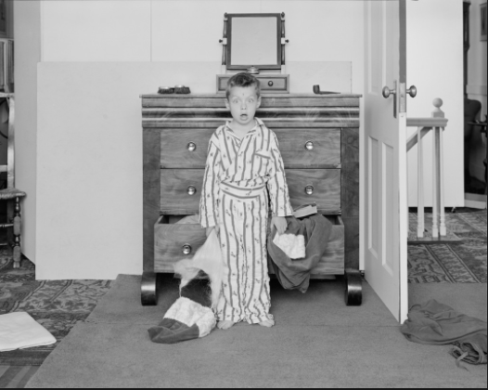

Slide 29
Notes:
Title: The Discovery

Slide 30
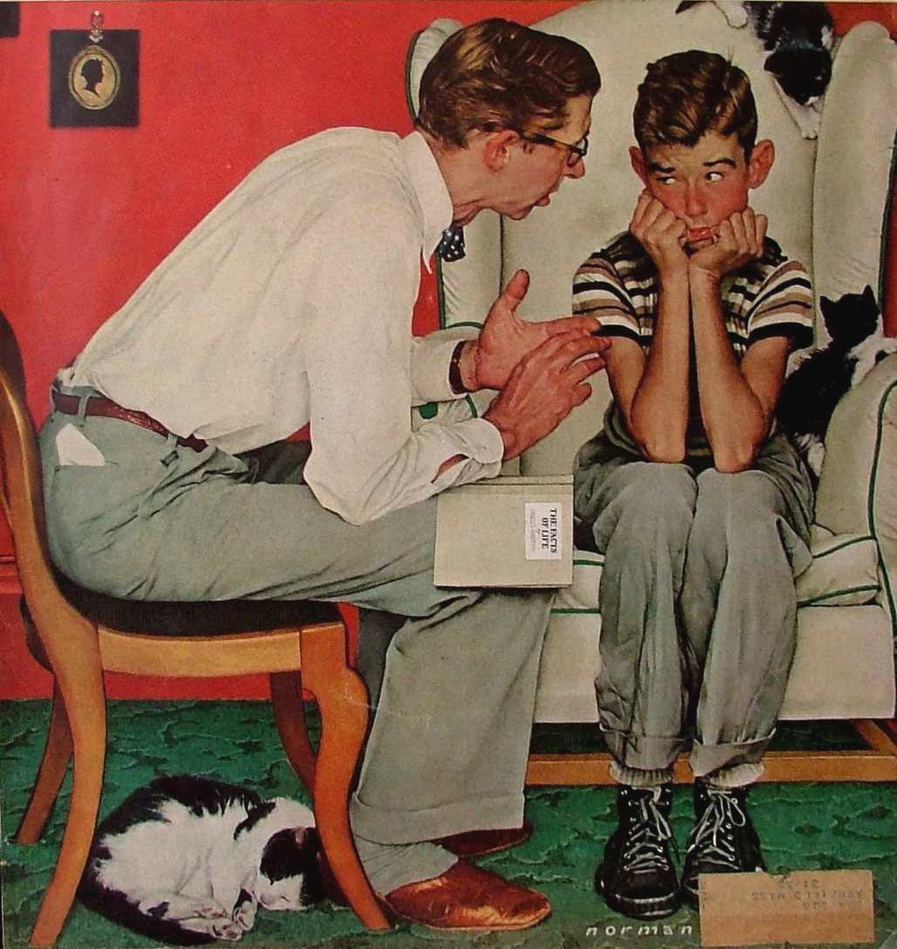
Notes:
Title: The Talk
The book on the dad’s lap The Facts of Life

Slide 31
Notes:
Title: The Fight

Slide 32
Notes:
Title: Girl at Mirror

Slide 34
Notes:
Title: Moving Day Look Magazine May 16, 1967

Slide 36
Notes:
Title: Moving Day Look Magazine May 16, 1967

Slide 37
Use Norman Rockwell’s painting “Moving Day” to make a tree map with the help of your table partner.
Tree Map
See Infer Cite Explain
(facts) (Claim) (Support) (Warrant)

Slide 38
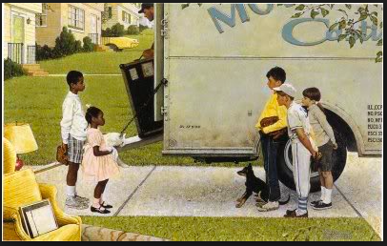
On your own, use your tree map, to write a constructed response.
Make a claim based on your inference.
Support your claim with text evidence (cite).
Explain your text evidence. Give your warrant of proof. Explain how the evidence proves your claim. SAY MORE STUFF!

Slide 39
Examine the Norman Rockwell Painting given to you by the teacher. Based on what you see, make an inference about what is happening in the painting. Use that inference to make your claim. Support that claim by citing text evidence from the painting. Provide a warrant of proof by explaining your evidence (say more stuff!!). Your warrant of proof will connect the evidence to the claim. It will put all the pieces of the puzzle together so the reader sees the big picture and is convinced that you’ve proven your claim. Your response should be 1-2 paragraphs long. In addition to the objectives listed below, be sure to include the title and the artist in your paragraphs. You will receive a utahcompose.com score and the teacher will also evaluate your writing on your ability to meet the following objectives: I can write a claim. I can discern what is relevant text evidence. I can cite the relevant text evidence to support the claim. I can effectively write an explanation that describes in detail how the evidence supports the claim.​

Slide 40
WHOLE CLASS ESSAY
This is the result of DeAnna’s collaboration with one of Miss Nielsen’s 8th grade English classes. As the students talked, DeAnna recorded and polished the writing.
Norman Rockwell’s painting, Moving Day, depicts the awkward, yet innocent meeting between a new black family and a white family in suburban America. The painting gives a sense of hope and reassurance about race relations in the United States.

Slide 41
The painting shows the children of a black family moving in. It is apparent that the family is moving in because the moving guy is pushing furniture out of the van. We also know that it is the black children who are new to the neighborhood because they are standing next to where the house would be, while the white children are coming from the street. Most likely, this is the first black family to move into this neighborhood. This is exhibited by the curiosity of the white children.

Slide 42
The encounter between these two sets of children is awkward because there is quite a distance between them. This distance shows that the children are obviously uncomfortable with meeting each other, and not quite ready to fully engage. It is also awkward in that the white children seem very interested and curious about the new kids on the block. The white kids are leaning in toward the black children showing both curiosity and wariness. The black children are leaning back and have an expression of caution on their faces. They are not sure how they will be received by the children of this neighborhood.

Slide 43
The meeting is not only awkward, it is also an innocent moment. Rockwell paints both children with baseball equipment, showing a mutual interest that binds these kids together regardless of their color. However, there is caution on the part of the tall black boy. He is hiding the baseball glove behind his back unsure of whether he will be accepted or not.

Slide 44
The moment also appears to be touching because of the expressions on the faces of the white children. There is no look of hatred or cruelty, merely fascination. The moment is also sweeter because the painter’s subjects are children giving the painting a more innocent theme, showing the importance and contributions of children.
The painting is hopeful because it gives a sense that the children or next generation will be less fearful, less ignorant, more tolerant and more accepting.

